Slide 1






A29 Team 1 NGNRS
Chan Ming Han​
Crystal Cheong​
Ng Mu Rong​
Cheong Chi Hian​
Ang Jun Koon

Slide 2


Purpose
A one-stop-shop for all real estate needs to provide a user-friendly and efficient search experience, helping users make informed decisions and find their perfect property.

Slide 3



Target Audience
Users
Stakeholders
Homebuyers
Home sellers
Renters
Real estate investors
Real estate agents
Homey development team
Homey management team
Real estate agents and agencies
Potential investors
Potenntial Advertisers

Slide 4




Product Scope
Property Listings
Agent Connection
Property Search

Slide 5
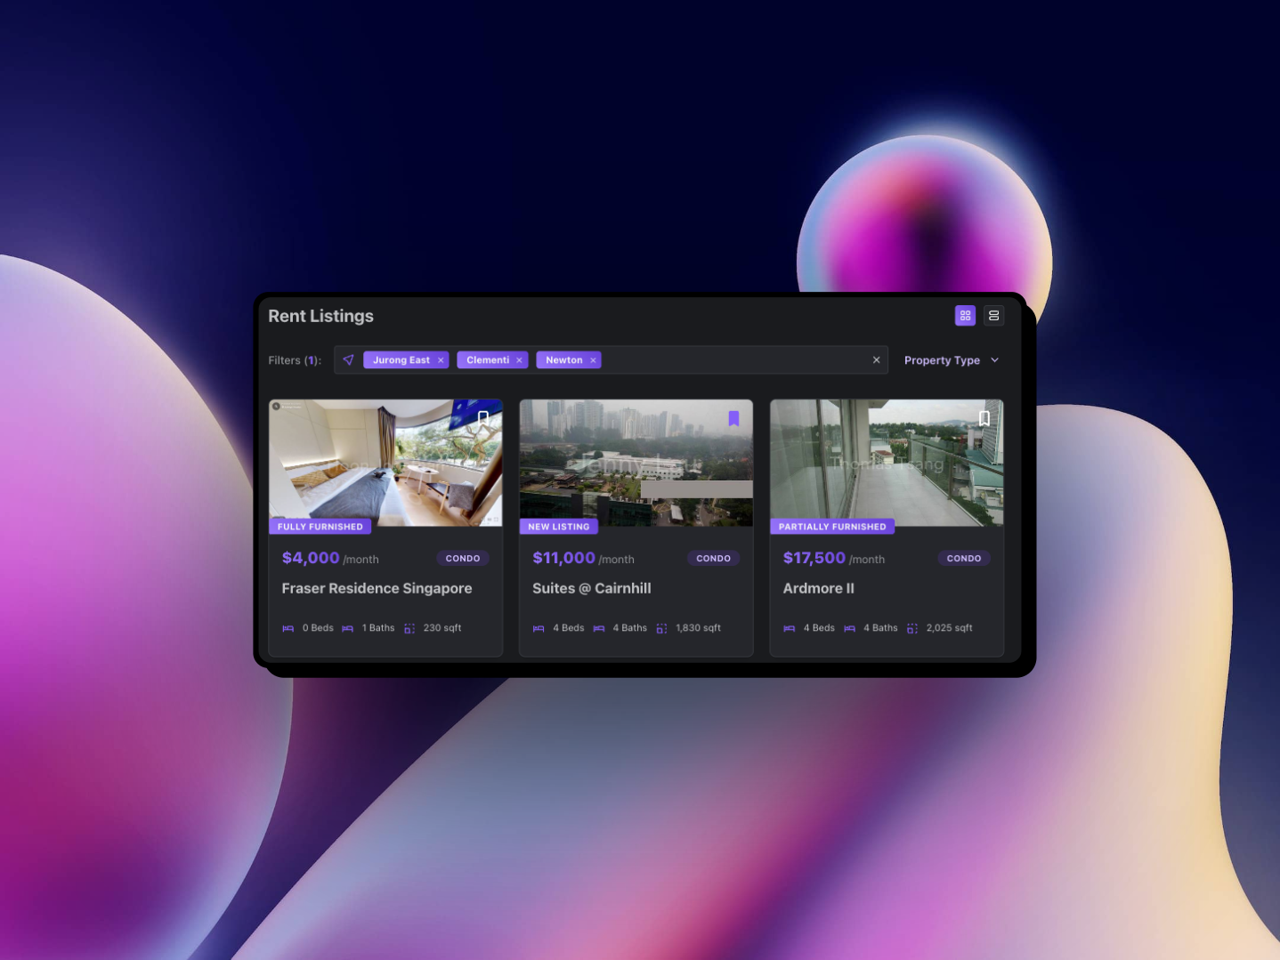
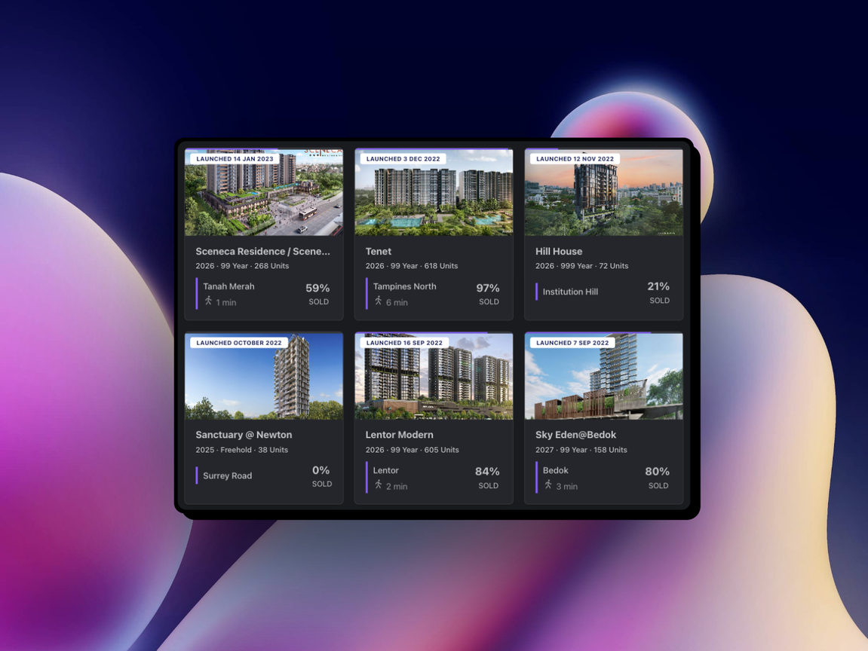
Features Overview
Search listings by property type and location
Save your favourite listings and view them at a glance
Explore neighbourhoods and latest condo launches

Slide 6


SDLC Activities
Design
Testing
Lab 2
Lab 4
Requirement Specifcation
Implementation
Maintenance
Lab 3
Lab 5
Lab 1

Slide 7

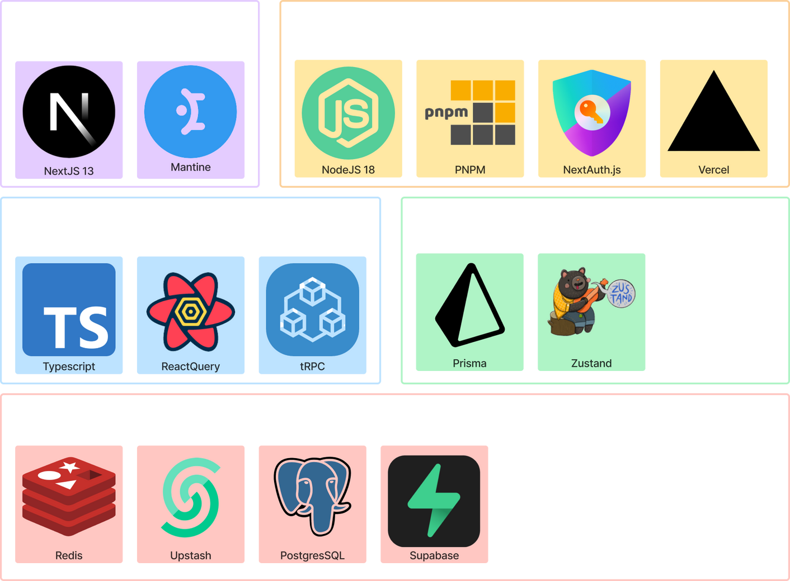
Tech Stack
Presentation
Application
Business
Persistence
Database

Slide 8


SE Practices & Traceability

Slide 9

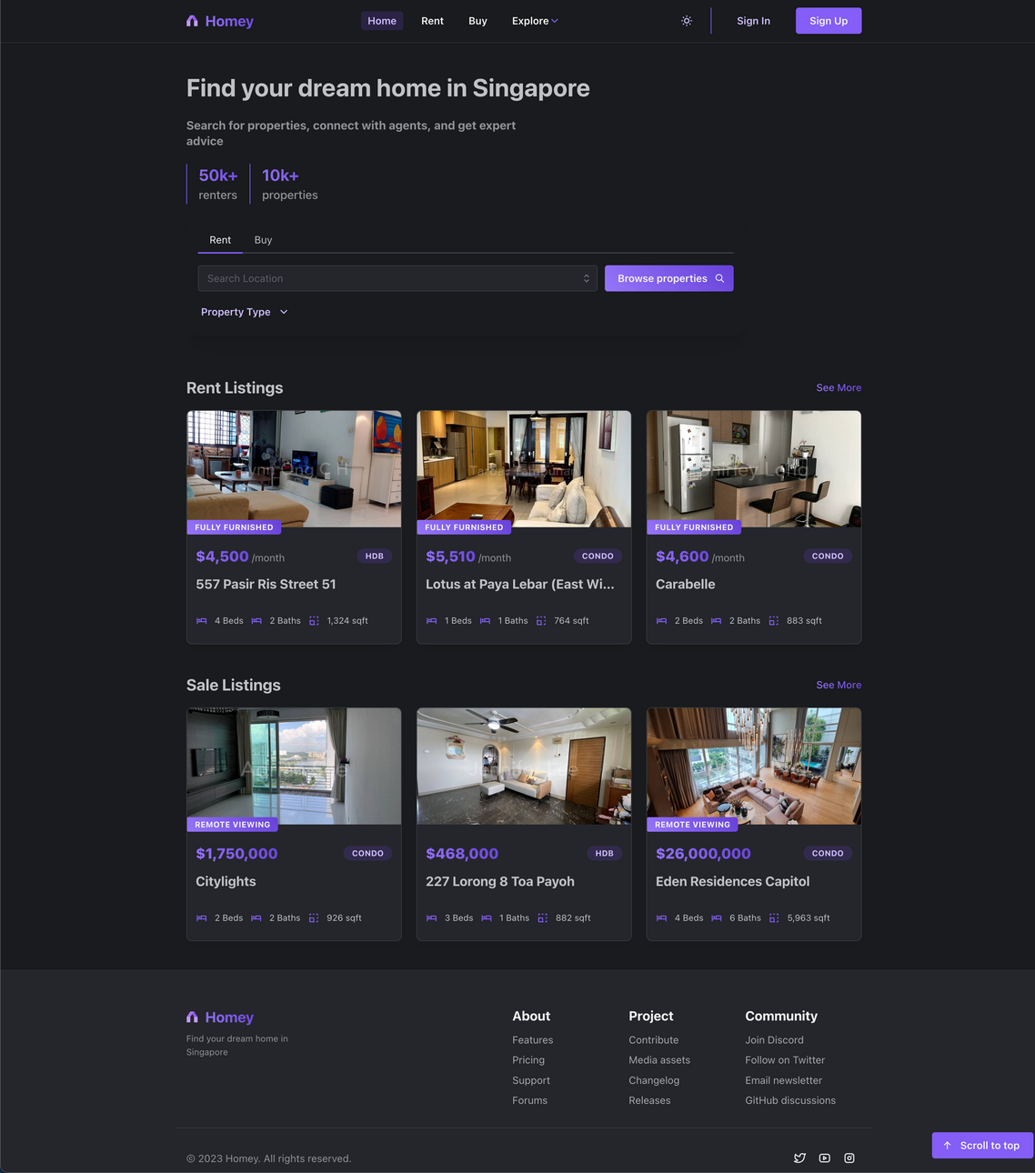
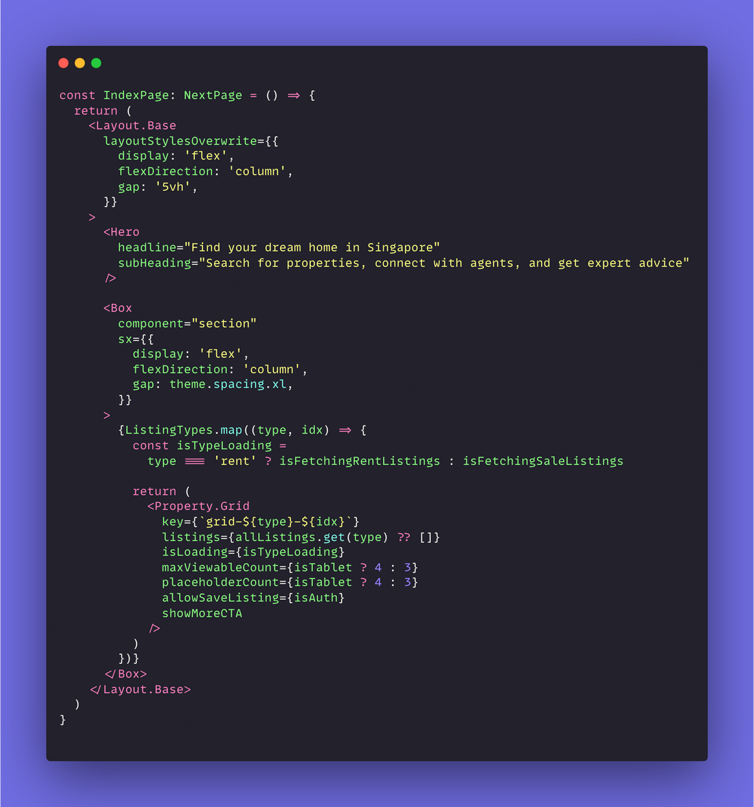
Reusability & Modularity
BaseLayout
PropertyGrid

Slide 10




Extensibility
Boundary (Presentation)
Data
Request
Control
(Logic)
Data
Request
Designed to be scalable and robust
Flow of dependencies trend downwards
Logic layer at the core of the application
Entity
(Data)
Notes:
the main distinction prolly be our extensibility
rn there are lots of property platforms in sg but not one that compiles listings from all these platforms
homey's extensibility allows for the integration of various real estate platform, starting with 99.co for our initial launch and subsequently, other platforms such as iProperty and PropertyGuru in our future roadmap

Slide 11
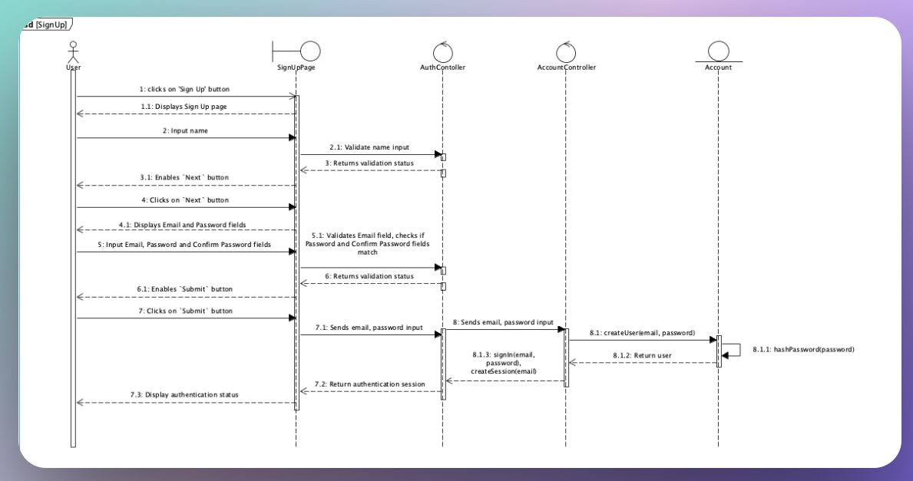
Traceability (SignUp)

Slide 12
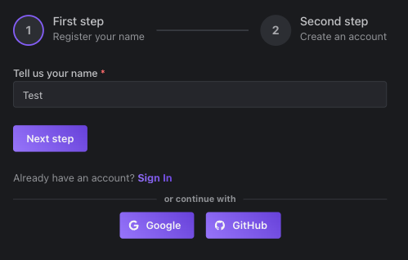

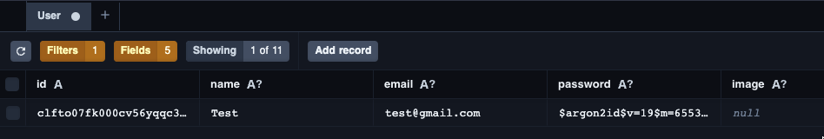
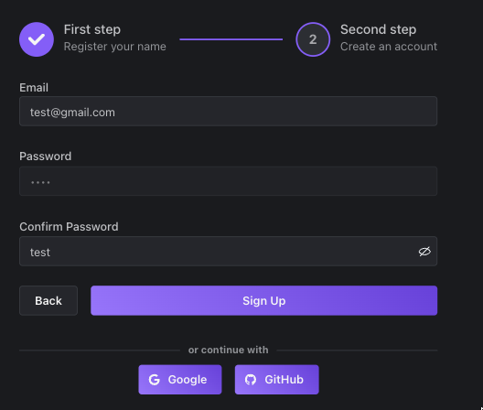
Traceability (SignUp)
Submit on the frontend
Create new User in the backend
Password salt-hashing with Argon2
Insert new database record
Return User data to the frontend
Create new session
Persist in state management

Slide 13
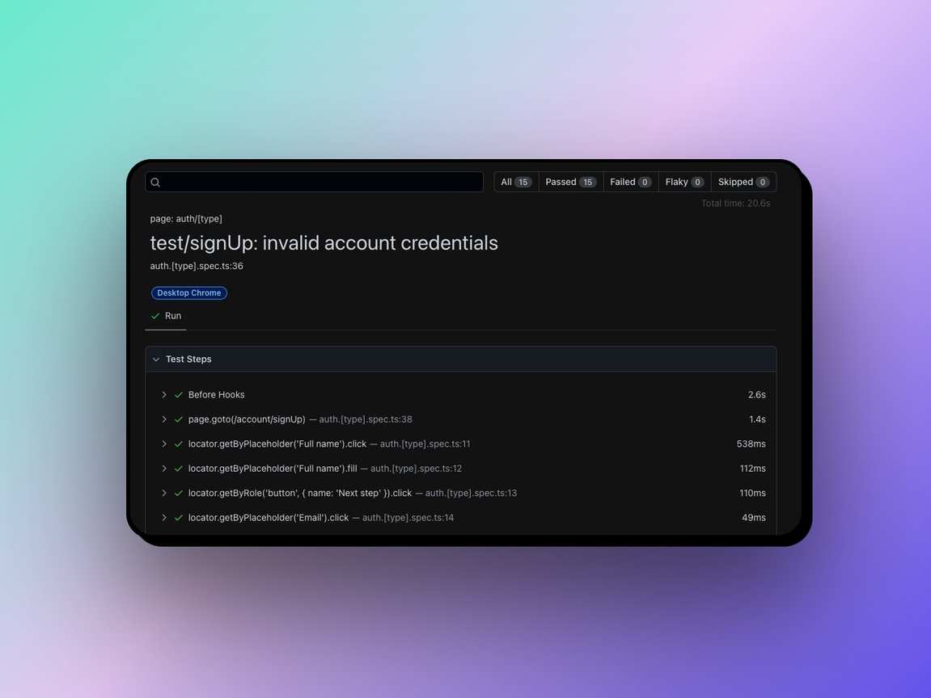
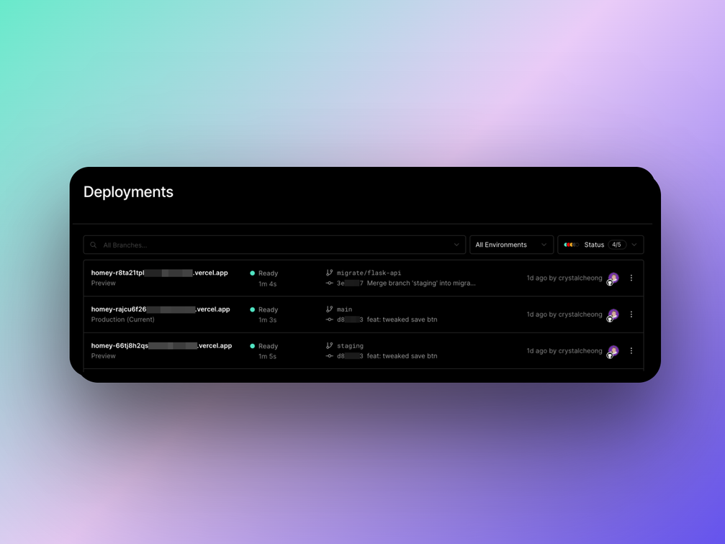
Continuous Integration
Faster development with reduced risks
Shorter review time
Version control and branching
Better code quality & faster bug fixes
End-to-End Testing with Playwright
Tools Used
Automated E2E Testing: Playwright
Deployment: Vercel
Code Formatter: ESLint, Prettier
Version Control: Git, Github
Deployment on Vercel

Slide 14
Maintenance Roadmap
Expand to property catalogue within Southeast Asia market
Integration with other real estate APIs
Continuously monitor property market

Slide 15

Product Demo
homey-sg.vercel.app

Slide 16
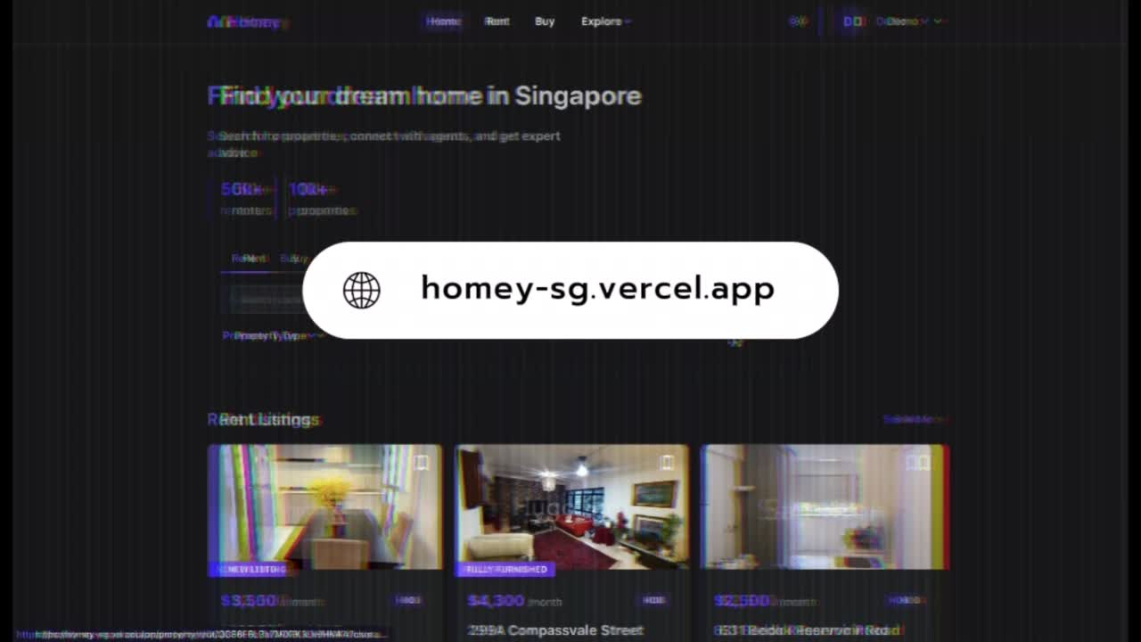

Slide 17


Thank You
Any questions?

